Slide 1



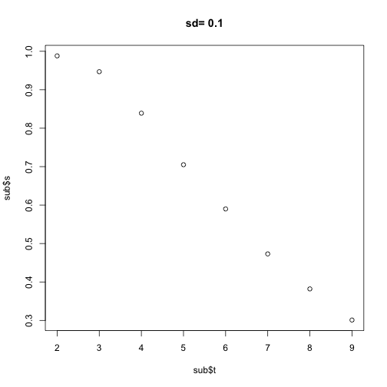
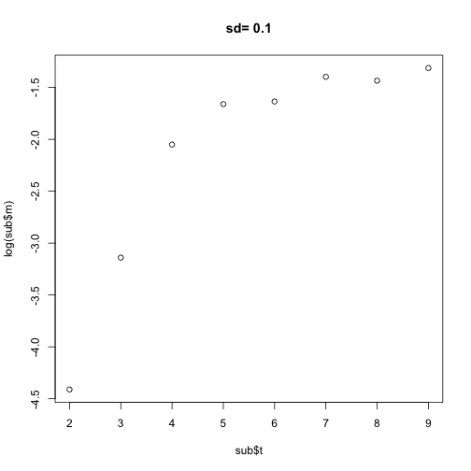
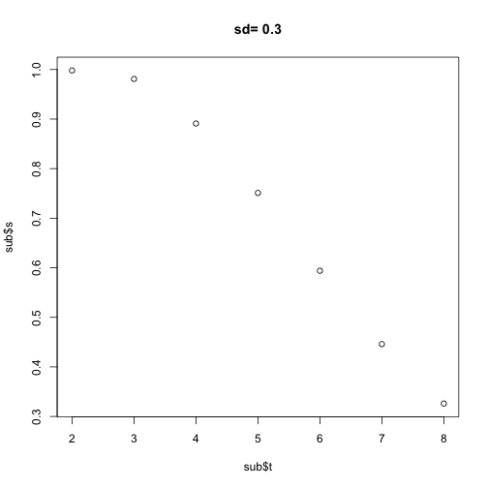
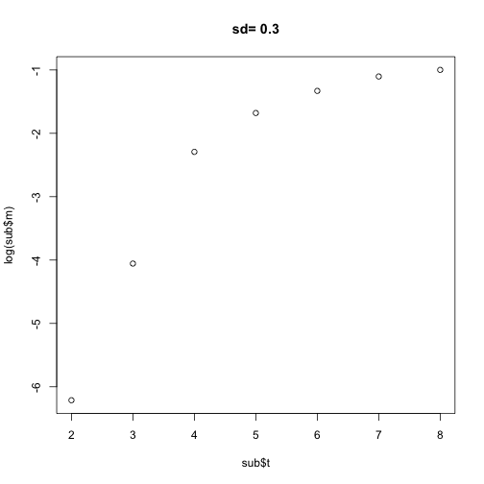
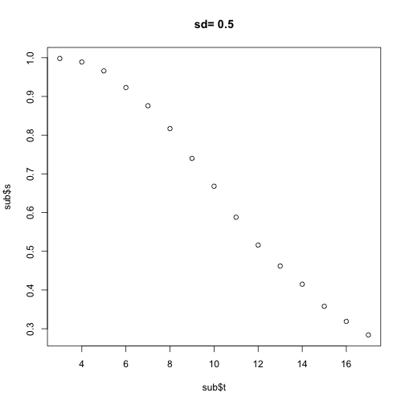
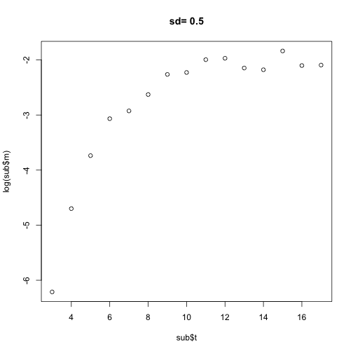
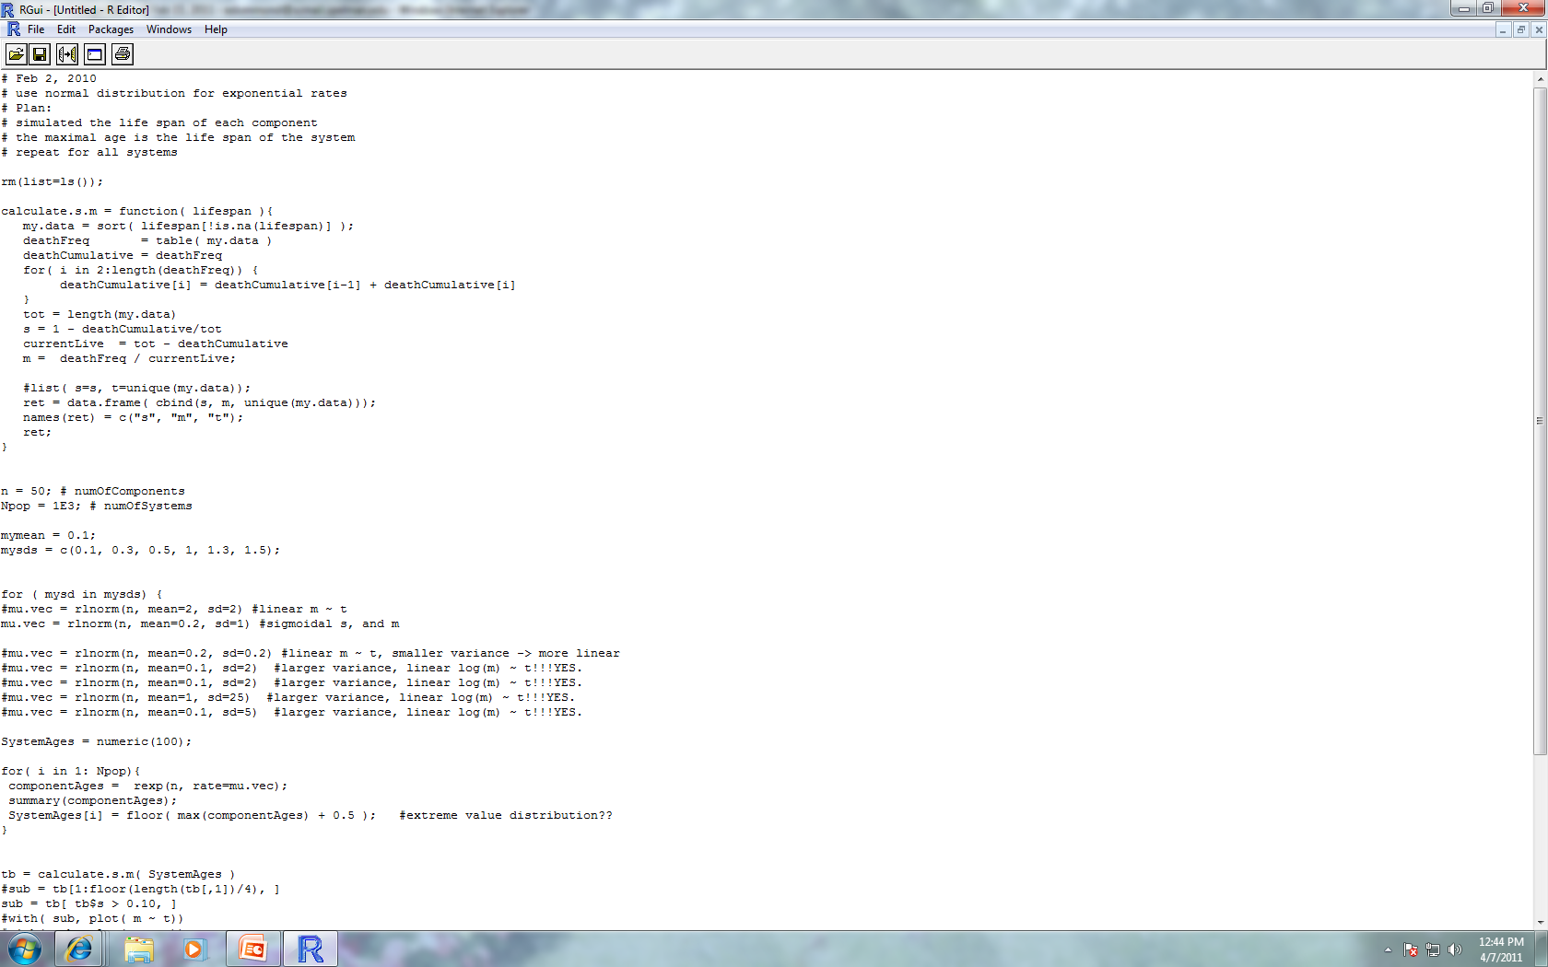
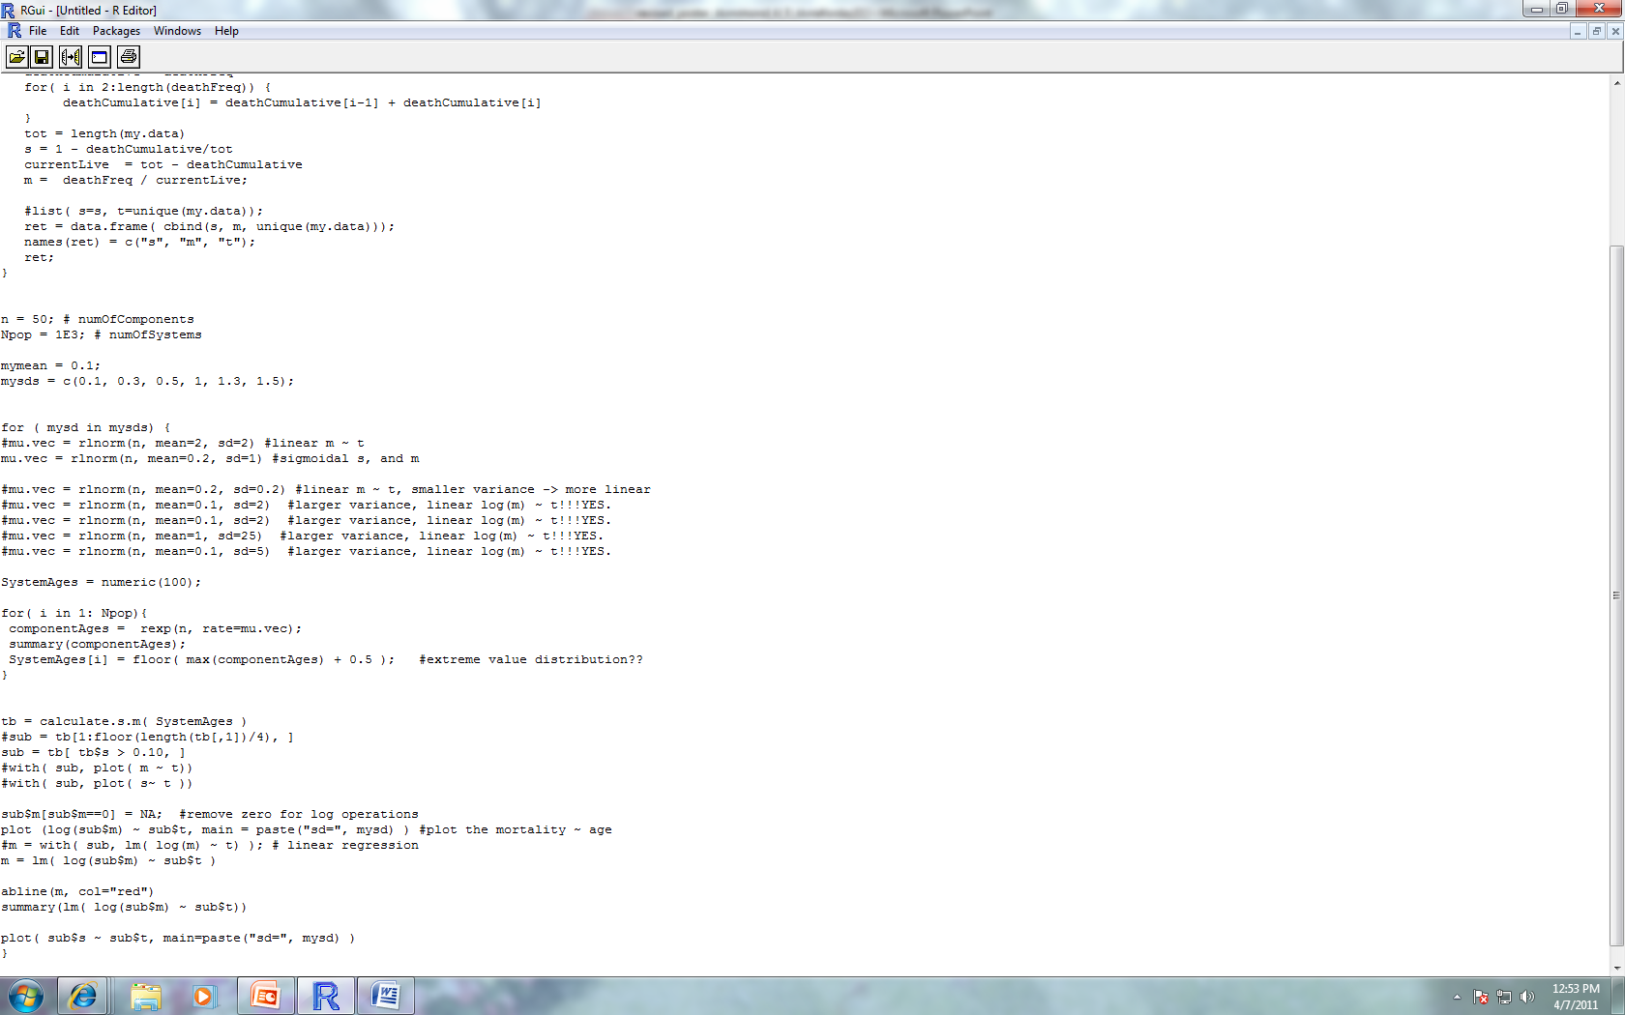
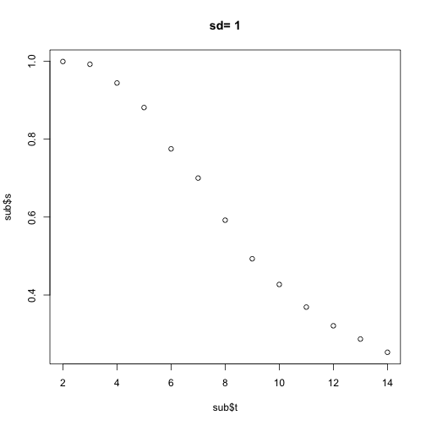
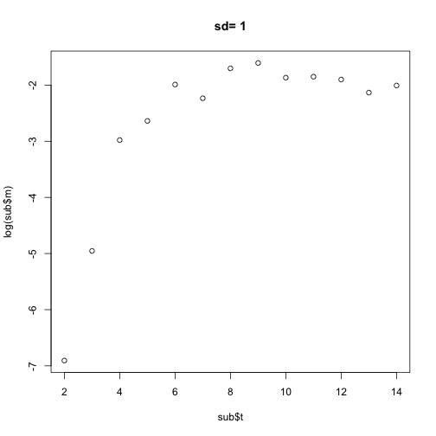
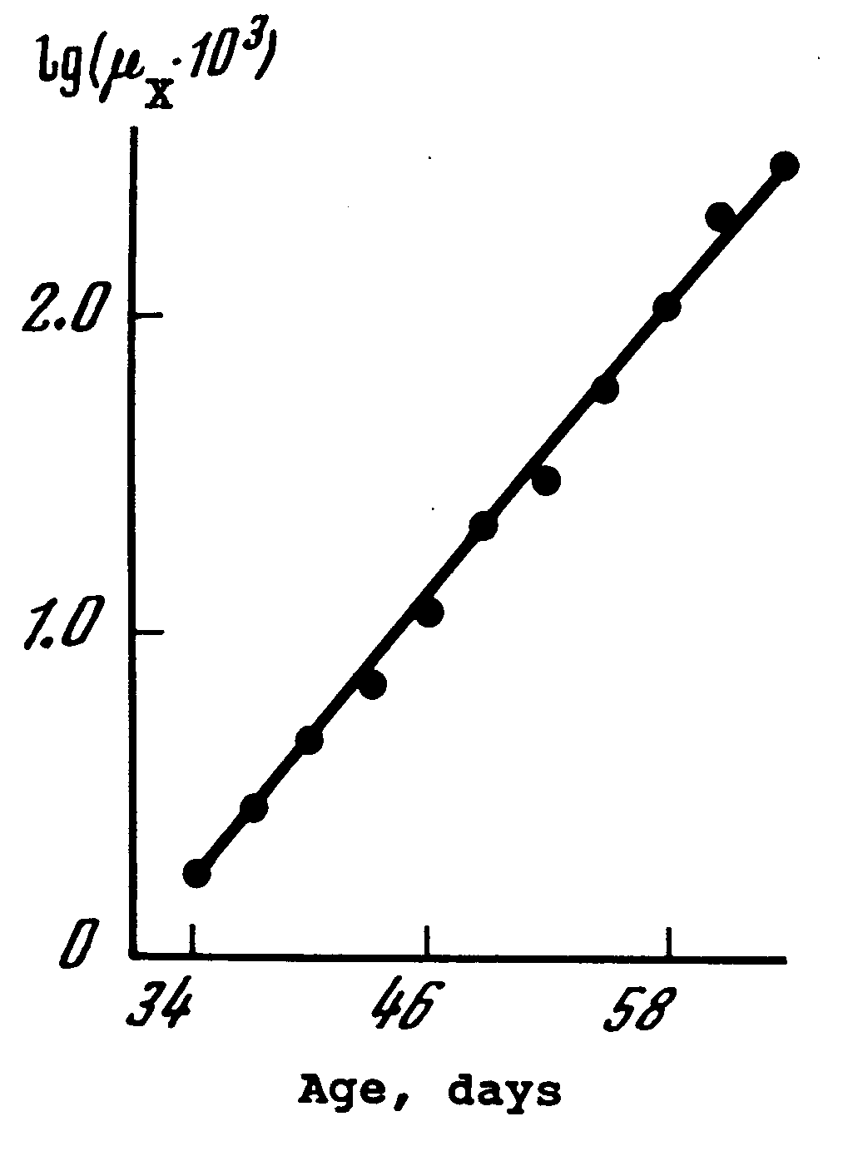
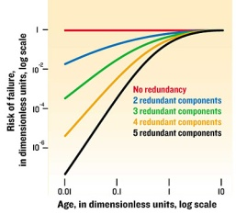
Heterogeneity is a Key Factor of Biological Aging Based on Reliability Modeling Erika Dommond Dr. Hong Qin, Ph.D., Biology Department, Dr. Nagambal Shah, Ph.D., Mathematics Department
Introduction
Aging is defined by the increasing risk of failure with time. In terms of organisms, this increased risk of failure can lead to sickness and ultimately death. Therefore, deciphering the mechanisms by which cell components of a biological system age is of great interest. In terms of the aforementioned systems, components are configured in a functionally redundant manner. It follows that the failure of one component does not lead to the death of the entire system . A system fails (dies) when all of its components fail; which can take place at homogeneous (constant) failure rates or heterogeneous (non-constant) rates. Consequently, it is this accumulation of damage to the components which in turn leads to the aging of the system. When modeling the failure rate of a biological system, its behavior leads to a Gompertz statistical model. This model is characterized by an exponential increase in failure rates over time; a key biological feature of aging. In previous studies, the classical reliability model employed homogeneous components yet failed give rise to a Gompertz statistical model. In this study, heterogeneous, or non-constant failure rates are explored with hopes of giving rise to the aforementioned key biological characteristic of aging.
Objective
Determine after performing simulations whether the application of heterogeneous failure rates gives rise to a Gompertz Model, the key biological feature of aging.
Heterogeneity and Failure Dynamics
Viabilty
Failure rate
Low Heterogeneity
Time
Time
Method & Results
Utilize R (statistical programming package) to create a reliability model which simulates the application of non-constant failure rates to the components of a system.
Viabilty
Failure rate
Time
Time
Viabilty
Failure rate
Time
Time
Viabilty
Failure rate
High Heterogeneity
Gompertz Law of Mortality
This graph (left) shows the general behavior exhibited by the Gompertz Model when the logarithm of the failure rate is plotted against time. One expects a linear trend, as shown.
Time
Time
Log of Failure Rate
Conclusions
Simulations have shown that heterogeneity can reproduce the exponentially increasing failure rates as dictated by the Gompertz Law of Mortality; the key biological feature of aging.
There is non-linear correlation between the heterogeneity measured in variance and Gompertzian rate of aging.
The codes shown above exhibit the method by which the lifespan of 50 components was simulated with exponential failure rates applied. Further, the maximal age, also known as the life span of the entire system, was simulated for the total number of systems.
Time
References
Gavrilov, Leonid., Gavrilova, Natalia., (2001). The Reliability Theory of Aging and Longevity. 528-536
Gavrilov, Leonid., Gavrilova, Natalia. (2006). Models of Systems Failure in Aging. 47-51, 57-60.
Gavrilov, Leonid., Gavrilova, Natalia. (2003). The Quest for a General Theory of Aging and Longevity. 2-7.
Hellemans, Alexander, Mullins, Justin, Lal, Amit. “Why We Fall Apart”. IEEE Spectrum, Vol. 41, no. 9. September 2004, p. 3.
Acknowledgements
I would like to extend a sincere thank you to the Howard Hughes Medical Institute at Spelman College (52006134) and my advisors, Dr. Qin and Dr. Shah for their continued support. Additionally, I would also like to thank Sydney Hamilton for her creative assistance in the production of this poster.
The left diagram illustrates subsystems composed of a various number of components. As the graph shows, early age failure rates decrease with an increase in components.

